Slide 1
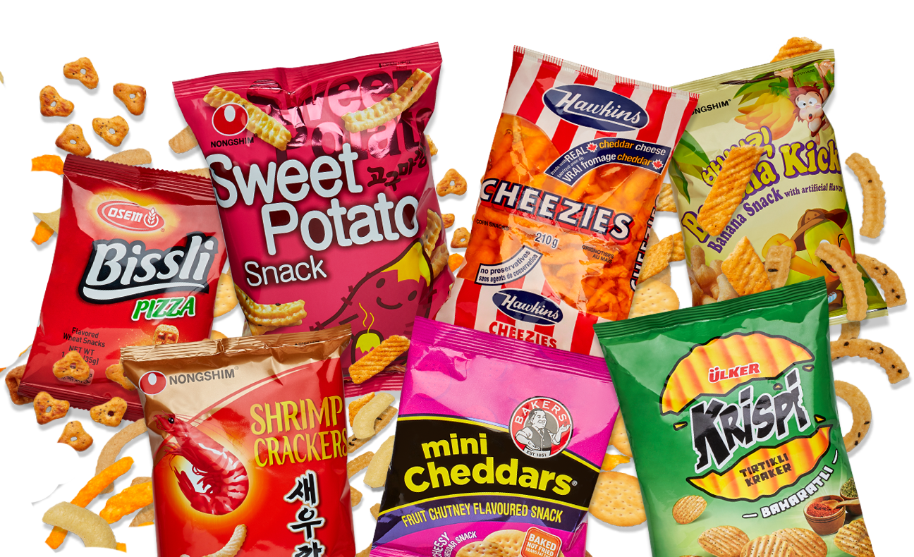
PodKnow:
Machine Learning
Harini Booravalli
Christopher Edgecombe
Jeremy Hudson
Jamie Weathers
Kun Vincent Yang
Team Snack Overflow

Slide 2
Tasks Breakdown
Harini
LSA model applied on single words
LSA visualization
Christopher
Topic modeling using LDA for single words.
Visualization of LDA Model (Words)
SciKit implementation for LDA model visualization
Jeremy
Topic modeling using Gensim LDA with bigrams
Comparing single words topics to bigram results

Slide 3
Tasks Breakdown
Vincent
Find out if a given topic with in 200 podcasts is whether a trendy word, based on the topic occurrence.
Jamie
Random forest regression on association between word count and confidence scores of transcripts.
Notes:
Collector Application and Google Stats.

Slide 4
Harini
Using LSA for topic modelling
Goal :- To perform topic modelling on the podcast data .
Machine Learning Model Used :- Latent Semantic Analysis
Results:- 160 topics were discovered
Latent Semantic Analysis (LSA) is a framework for analyzing text using matrices.
Find relationships between documents and terms within documents.
scikit learn , a Python library for doing machine learning, feature selection, etc
A simple way to add structure to text is to use a document-term matrix.
Once we have the document term matrix, we apply lsa(Combination of Countvectorizer/Tf-IDF +SVD)
The result gives us the topics .

Slide 5
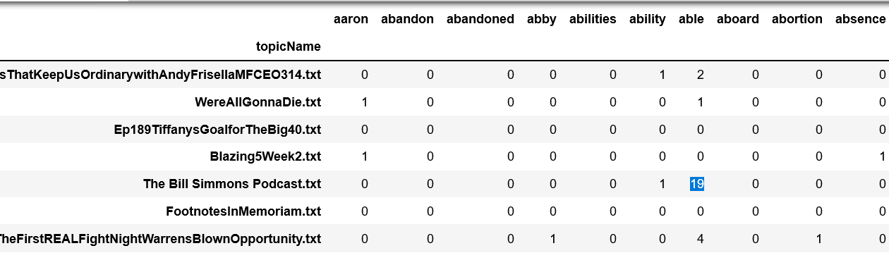
Harini
LSA Model
Doc term matrix dimensions 193*7990
Each row represents a document. Each column represents a word.Each entry equals the number of times the word appears in the document.
Note: order and proximity of words in documents is NOT accounted for. Called a "bag of words" representation.

Slide 6
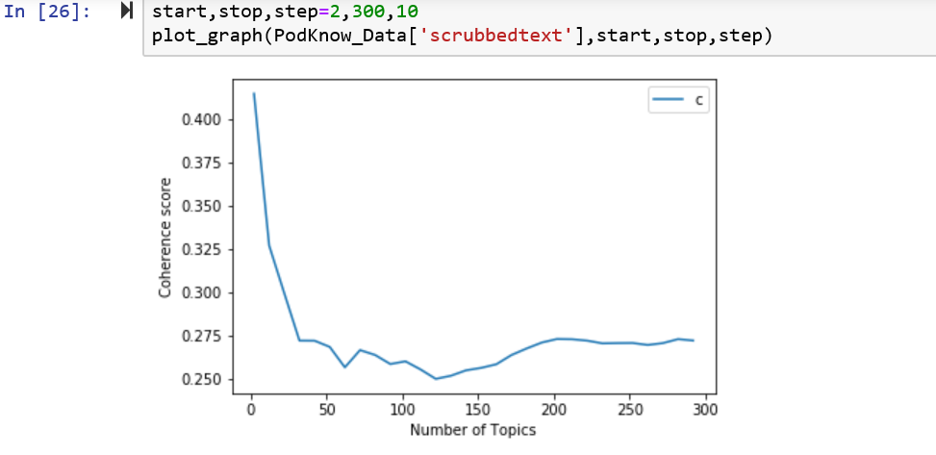
Harini:
SVD on the results of LSA
Once we have received the document term matrix, we apply the LSA model on it .
In this case we are using a countvectorizer. Based on the coherence scores given below .
Chosen the number of topics to be 160.
Hence our resulting will matrix is
193*160
193 documents * 160 Topics(LSA components)
Each LSA component is a linear combination of words.

Slide 7
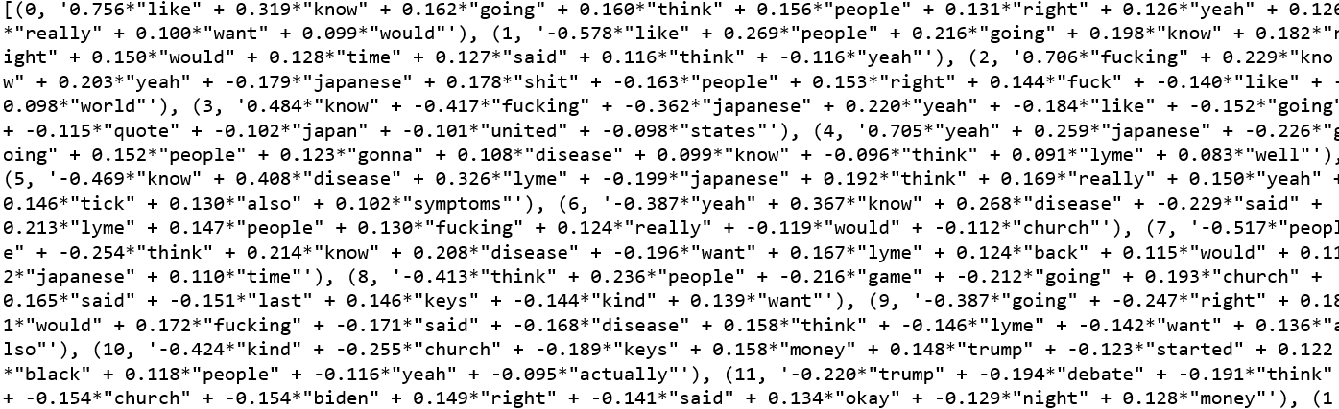
Harini:
Results of LSA

Slide 8
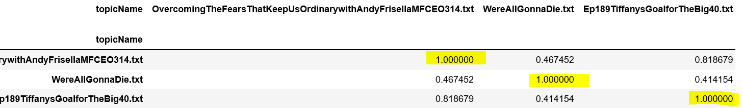
Harini
Document similarity using LSA
The similarity between two documents is a function of the angle between their vectors in the term vector space.
Here we are using the LSA matrix to get the similarity between the documents.

Slide 9
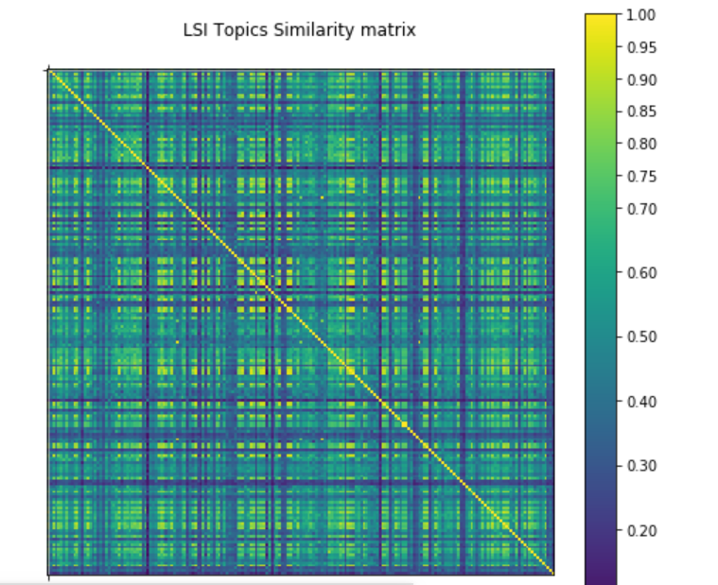

Slide 10
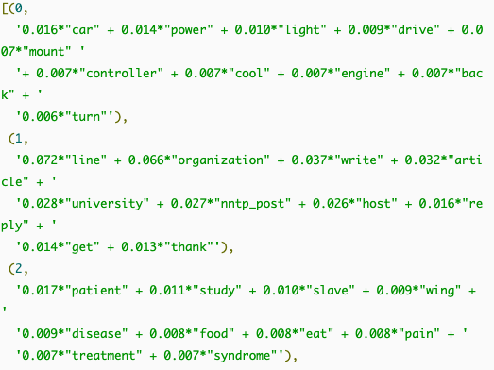
Christopher
T1 - Goals of Machine Learning / Analysis
The overall goal of topic modeling is to find which topics are most prevalent in the podcast so we can get a better idea of the content.
For the case of words, we would like to know which words are most important to a specific topic and what those topics are.

Slide 11
Christopher
T2 - Question
Which topics are seen in the podcast text data when each topic only consist of words?
Project Question: What is the content of the podcasts?
The data from these topic models will help us answer the project question.

Slide 12
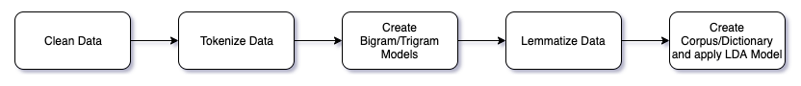
Christopher
T3.1 - Describe the Method
LDA models were created from single words using SciKit.
Multiple LDA models were created in order to find the optimal number of topics per podcast.
LDA is originally an unsupervised learning algorithm. However, if we were to implement Labeled LDA for categorization this would become a supervised learning model.
These models are important for finding the content of each individual podcast.

Slide 13
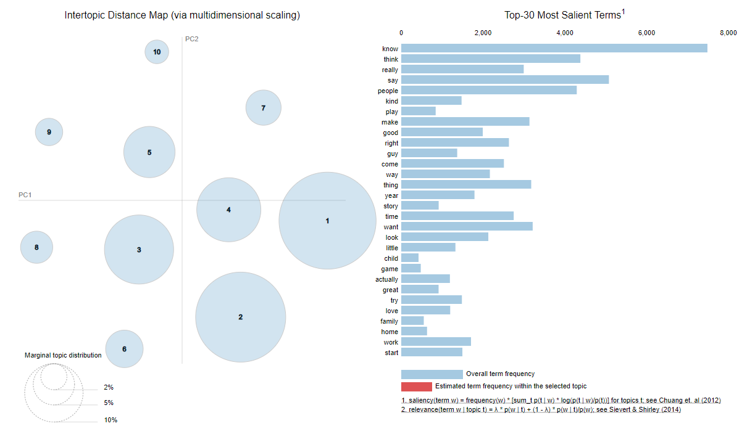
Christopher
T3.2 - Outcomes/Results (Example: MFCEO Podcast)

Slide 14
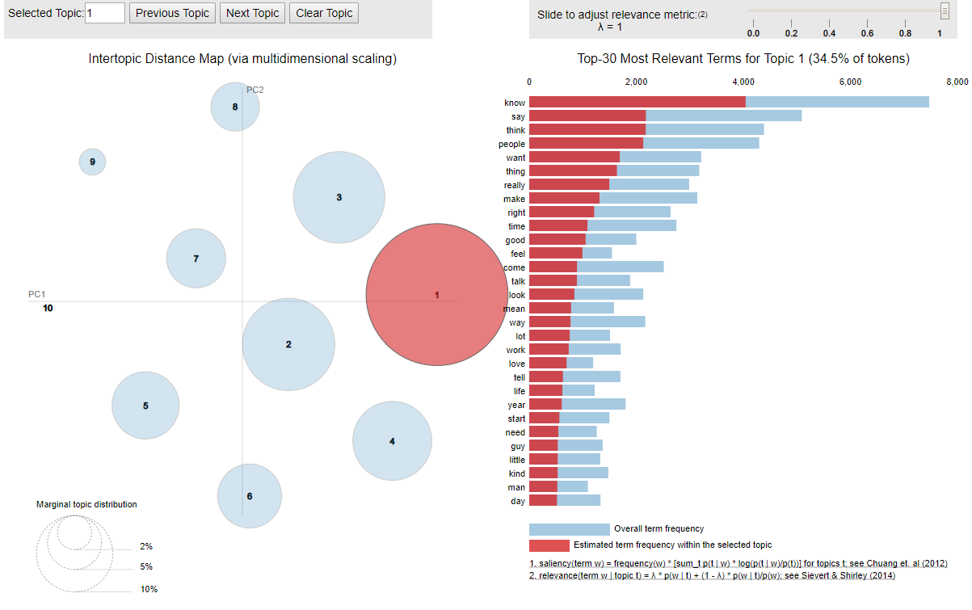
Christopher
T3.2 - Outcomes/Results (Example: MFCEO Podcast)

Slide 15
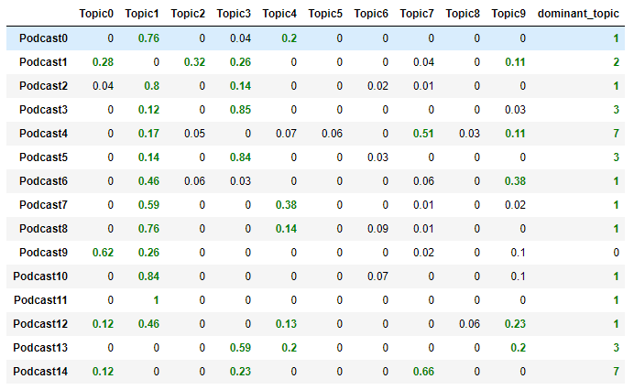
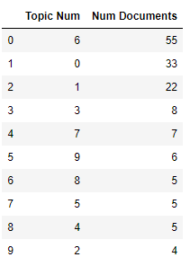
Christopher
T3.2 - Outcomes/Results

Slide 16
Jeremy
T1 - Establishment of Machine Learning Goals
Using bigrams, determine topics for given podcasts
Find nuances in topics using bigrams as opposed to using the entire document

Slide 17
Jeremy
T2 - Formulate the Question
How do Gensim LDA models built from bigrams compare to models built using the entire document?
Answering this question will provide greater insight into topics discussed

Slide 18
Jeremy
T 3.1 - Describe the Method
Determined topics from bigrams using Gensim LDA models
Answered the question by comparing and contrasting results from bigram models between results from the entire document

Slide 19
Jeremy
T 3.2 - Description of the results/outcomes
Many topics generated from bigrams appear to be independent from single word topics, although many bigram models provide greater clarity into a topic

Slide 20
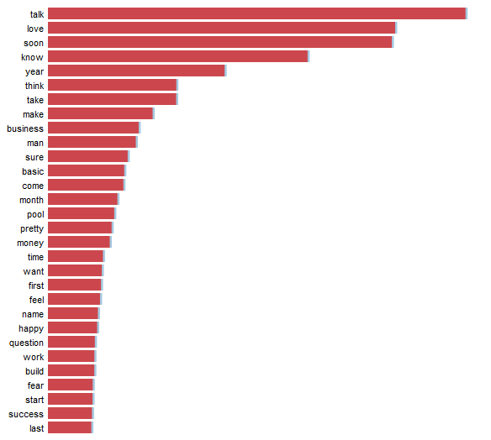
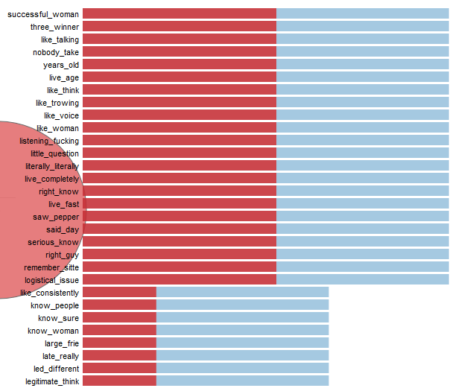
Jeremy
T 3.2 - Description of the results/outcomes (MFCEO podcast)

Slide 21
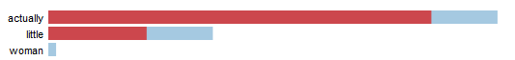
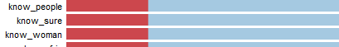
Jeremy
T 3.2 - Description of the results/outcomes

Slide 22
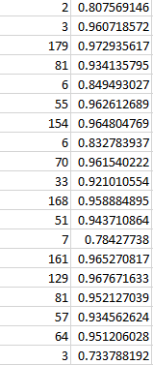
Jamie
Predicting Confidence Scores based on Word Count
Context
Previously, we noticed that while skimming parts of our data set, lower confidence scores were associated with transcripts of a lower word count and higher confidence scores were associated with a higher word count.
The Question
Can we predict the confidence score of a transcription based on the word count?
Why?
We want to make sure our transcription results are reliable as possible, so transcripts with a lower confidence score are bothersome.
Despite that Google's Speech Recognition is the best out there we want to know about its limitations.
(Google SR WER = 9%, beating Microsoft Speech's 18% and Sphinx's horrible 37%)
https://www.researchgate.net/publication/314938892_Comparing_Speech_Recognition_Systems_Microsoft_API_Google_API_And_CMU_Sphinx

Slide 23
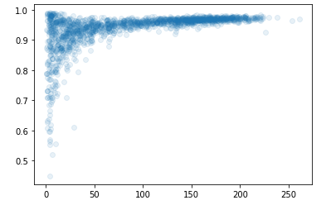
Jamie
Training
Procedure
There's roughly 2200 samples of transcript data.
We use 80% of the results as training data, and 20% as testing data.
Train our data using random forest regression.
Plot of results from 1 to 1600.
Note the high occurrences of transcripts with low word count and a high confidence score (1, ~0.99)
ConfScore
Wordcount

Slide 24
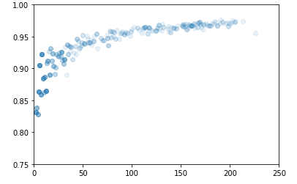
Jamie
Testing using Random Forest Regression
Outcome
Overall trend appears to reflect actual model, where transcripts with a higher word count have a higher score.
Fortunately many transcripts have a high word count.
Hard to predict confidence scores lower than 0.80 from word count (lack of data).
Can't predict that low word counts can also have very high confidence scores (Different methodology needed).
ConfScore
Wordcount
Results of a trained random forest model, with the word counts of 400 samples used as testing data.

Slide 25
Vincent
Task:
Find out if a given topic with in 200 podcasts is whether a trendy word, based on the topic occurrence.
Tools:
Used linear regression

Slide 26
Vincent
Procedures:
1.Count each occurrence of each topic.
2.Sorted the data based on occurrence, labeled top 10% of the topics as trendy topic, with classification 0=non trendy, 1= trendy.
3.Added new features, occurrence, trendy, and ascii to the data set.
4.Shuffled the data set.
5. Trained the model with 80 20 split, using linear regression.

Slide 27
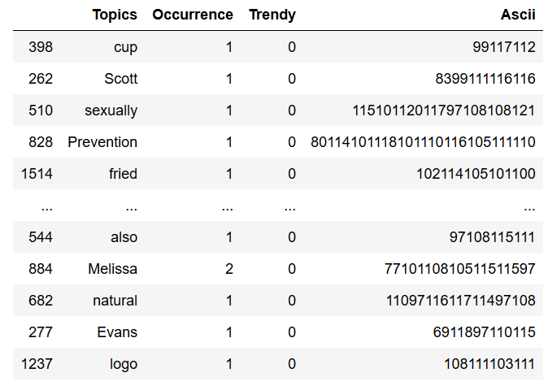
Vincent
Data:

Slide 28
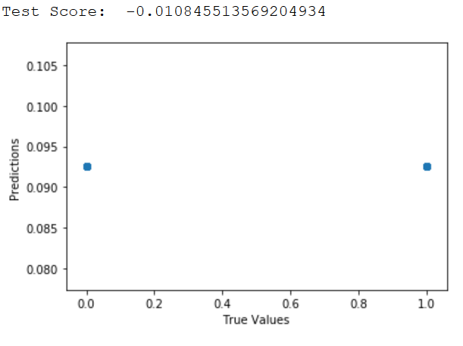
Vincent
Result:

Slide 29
Questions?

